Slide 1
Local Workforce Development Boards
Work-Based Learning Intermediary Grantee 8.22.2023

Slide 2
What is a workforce Development Board?

Slide 3
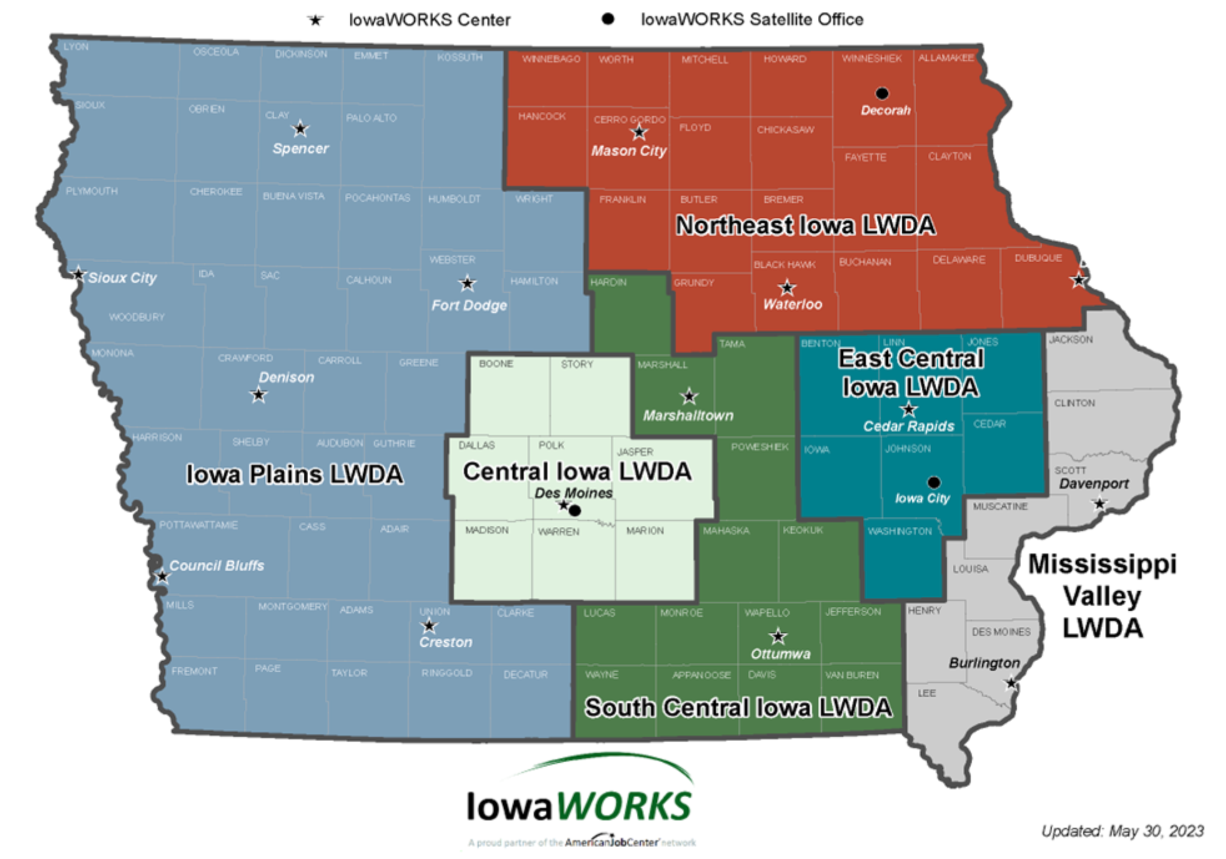
Iowa's Public Workforce System
Notes:
How do local Workforce boards support Iowa’s public workforce system?
(1) Provide strategic and operational oversight in collaboration with the required and additional partners and workforce stakeholders to help develop a comprehensive and high-quality workforce development system in the local area and larger planning region;
(2) Assist in the achievement of the State's strategic and operational vision and goals as outlined in the Unified State Plan or Combined State Plan; and
(3) Maximize and continue to improve the quality of services, customer satisfaction, effectiveness of the services provided.

Slide 4
Opportunity
Unlock the power of collective impact.
Notes:
While workforce Boards have been unknown or seen as program managers, there’s opportunity to transform regions through collective impact.

Slide 5
Benefits
Program Resources
Innovative Solutions
Funding Assistance

Slide 6
Purpose
Product
Providing Quality Assurance
Understanding Demand
Local Workforce
Development Board
Supplier
Market
K-12 Public Schools ⦿
Post Secondary Institutions ⦿
Private Career Schools ⦿
American Job Centers ⦿
Community Based Orgs. ⦿
Non-Profit Organizations ⦿
Government Agencies ⦿
Other Service Providers ⦿
⦿ Small Business
⦿ Medium Business
⦿ Large Business
⦿ Business Associations
⦿ Chambers
⦿ Economic Dev. Orgs.
⦿ Tourism Bureaus
Skilled Workforce
Manufacturer
Customer
Notes:
The vision for the Local WDB is to serve as a strategic leader and convener of local workforce development system stakeholders to provide strategy, goals, innovation (including technology), and oversight
Understanding the customer market demands to meet skilled workforce talent supply chain needs…
Conducting quality assurance with the public and private organizations that manufacturer and supply talent in a region

Slide 7
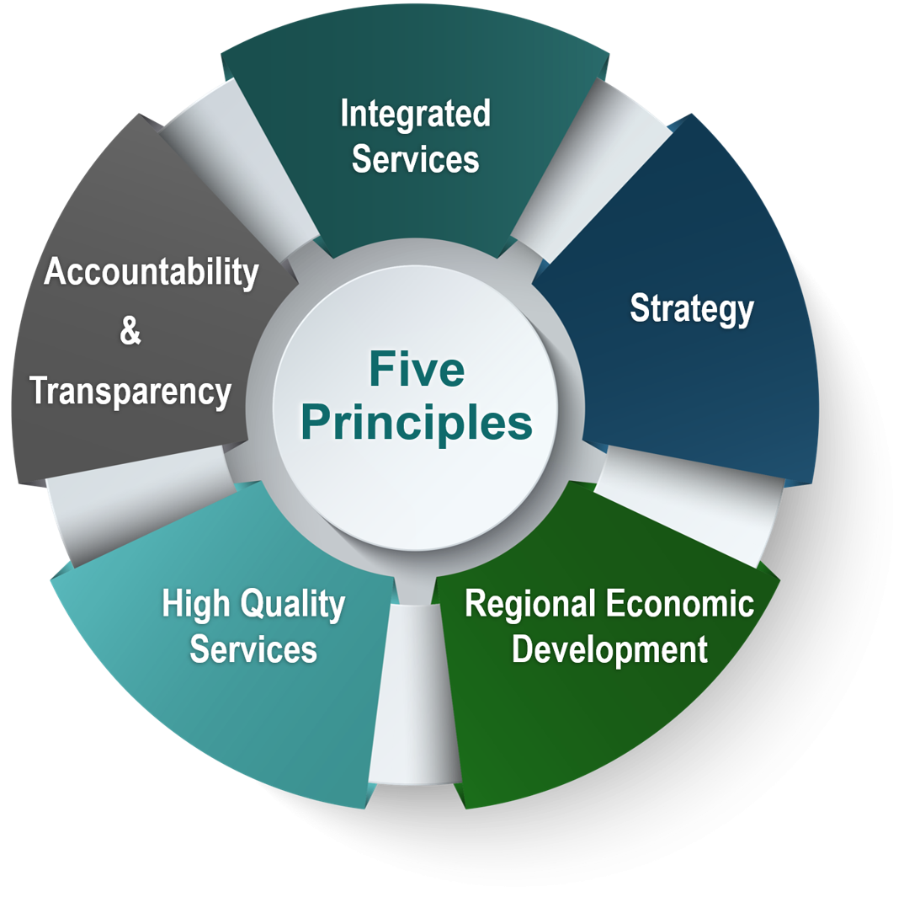
Function
Manage resources to deliver excellent customer centered service
Convene workforce stakeholders to align workforce system
Strategize and lead efforts to design the local workforce system
Optimize regional economies to develop sector strategies and career pathways
§ 679.300 What is the vision and purpose of the Local Workforce Development Board?
Notes:
The Local WDB functions to partner with employers and the workforce development system to develop policies and identify investments that support public workforce system strategies for regional economies, and developing effective approaches including:
To provide leadership, guidance, and leveraging of resources for workforce development efforts to improve sustainable employment opportunities
To provide governance, strategic planning (providing input for regional workforce plan), and fiduciary guidance
Engage in regional labor market analysis – focused on needs of our community
Identify promising practices in engaging businesses
Convening and facilitating local and regional sector partnerships
career pathway development & design
Implementing paid work-based learning opportunities, including apprenticeship, internship, etc.
Ensuring high quality, customer centered service delivery and service delivery approaches

Slide 8
Partners
Workforce Development
Apprenticeship
WIOA
Veteran (JVSG)
SCSEP
Vocational Rehabilitation
Job Corps
Nonprofit
Private Sector
CTE
Post Secondary
MSFW

Slide 9
Board Composition
53%
21%
16%
10%
100%
Business
Workforce
Government
Employment & Training
Total
10
4
3
2
=
19
Notes:
Business Provide employment opportunities in in-demand industry sectors or occupations, as those terms are defined in WIOA Section 3(23); and provide high-quality, work-relevant training and development opportunities to its workforce or the workforce of others (in the case of organizations representing business as per WIOA Section 107(b)(2)(A)(ii)
Workforce Must include one or more representatives of a joint labor-management, or union affiliated, registered apprenticeship program within the area who must be a training director or a member of a labor organization. If no union affiliated registered apprenticeship programs exist in the area, a representative of a registered apprenticeship program with no union affiliation must be appointed, if one exists;
Employment & Training – Economic Development, Higher Education, Adult Education
Government – Wagner Peyser & Vocational Rehabilitation

Slide 10
South Central

Slide 11
South Central Board Members
Kari Flaherty Ajinomoto
Randy Westman Johnson Machine Works
Natalie McGee Lucas County Health Center
Dillion Smith Farm Bureau
Zenna Boyd Ottumwa JBS
John Hall Marshalltown Area Chamber of Commerce
Warren Schaefer Agri-Industrial Plastics Company
Trena Beske Benchwarmers
Lori Wildman Alliant Energy
Dan Beeding International Brotherhood of Electrical Workers
Jon Klaus
Indian Hills Community College
Jennifer Wilson Indian Hills Community College
Shea Griener Greater Ottumwa Partners In Progress
Micheal Cockrum IowaWORKS
Kelli Hugo Iowa Vocational Rehabilitation Services
Lindsay Cale Ottumwa Job Corps
Business Open
Business Open
Union Rep Open

Slide 12
IowaWORKS Centers
Marshalltown
Hardin, Marshall, Poweshiek, and Tama
Address: 101 Iowa Avenue West, Suite 200 Marshalltown, IA 50158
Phone 641-754-1400
Email MarshalltownIowaWORKS@iwd.iowa.gov
Website
https://www.iowaworkforcedevelopment.gov/marshalltown
Facebook
https://www.facebook.com/IowaWorksMarshalltown
Ottumwa
Appanoose, Davis, Jefferson, Keokuk, Lucas, Mahaska, Monroe, Van Buren, Wapello, Wayne
Address: 15260 Truman Street Ottumwa, Iowa 52501
Phone 641-684-5401
Email OttumwaIowaWORKS@iwd.iowa.gov
Website
https://www.iowaworkforcedevelopment.gov/ottumwa
Facebook
https://www.facebook.com/IowaWorksOttumwa

Slide 13
Collective Efforts
Sector Partnership Grant
Results for America Fellowship
Convenings & Conferences
Labor Market Information
Youth Systems Building Academy
Intermediary Grant

Slide 14
Businesses
Business Consulting
Customized Training
Registered Apprenticeship
Work-Based Learning
Hiring Events
Notes:
Business Consulting
Save time and money using our resources to address workforce issues. We can:
promote job openings
keep you informed of hiring events
arrange interview space in a Job Center
provide career assessments
Job Matching
Job Center staff can help you:
write job descriptions
post job orders
screen job candidates
host recruitment events
Registered Apprenticeship
Visit the Registered Apprenticeship website at ​ www.earnandlearniowa.gov to learn more about the process and to connect with your local IowaWORKS Center.​
Program set up ​
Connect to existing programs​
Testimonials ​
Filling pipeline with quality workers​
Increase employee longevity​
Connection with Future Ready Iowa​ @ www.futurereadyiowa.gov

Slide 15
Serving Employers
Exploring and Building
Surviving Slow Down
Expanding and Developing
Worker Training / Work-Based Learning
Transition and Layoff Aversion
Finding More Workers/Expanding
Iowa Jobs Training Program (260E, F,G)
Registered Apprenticeship Development Fund (15B/15C)
Last Dollar Scholarship
Iowa Student Internship Program
Summer Youth Internship Program
Employers' Council of Iowa (ECI) Training Initiatives
Rapid Response Team
Voluntary Shared Work Program
Incumbent Worker Training
IowaWORKS job bank
Recruitment and hiring events
Home Base Iowa
Grants for Child Care
Employer Training Innovation
Iowa Vocational Rehab.
Work Opportunity Tax Credit (WOTC)
The Federal Bonding Program
Adult/Dislocated Worker
Iowa STEM Externships
Explore New Ideas
Workforce Development Boards
Business Sector Partnerships
Workforce Development Boards
Notes:
Worker Training / Work-Based Learning
Iowa Jobs Training Program (260E, F,G)
Registered Apprenticeship Development Fund (15B/15C)
Last Dollar Scholarship
Iowa Student Internship Program
Summer Youth Internship Program
Employers' Council of Iowa (ECI) Training Initiatives
Transition and Layoff Aversion
Rapid Response Team
Voluntary Shared Work Program
Incumbent Worker Training
Finding More Workers/Expanding
IowaWORKS job bank
Recruitment and hiring events
Home Base Iowa
Grants for Child Care
Employer Training Innovation
Iowa Vocational Rehab.
Work Opportunity Tax Credit (WOTC)
The Federal Bonding Program
Adult/Dislocated Worker
Iowa STEM Externships

Slide 16
Questions!

Slide 17
Committees
Full Board
Executive
Disability Access
Finance
Operations
Youth
Notes:
Executive
Handles urgent issues and acting on behalf of the SCIWA LWDB between meetings as needed and designated
Undertakes the transactional business of the board as specifically delegated to it by the Board
Reviews monthly reports and activities and recommendations of committees
Recommends the appointment and/or dissolution of regular and special committees
Reviews, develops, and recommends policies and procedures for the SCIWA LWDB and its committees
Operations
Reviews reports on program performance and corrective action issues.
Reviews and recommends approval of local policies and procedures.
Recommends program design opportunities for partners
Reviews and recommends approval for contracts, One-Stop Operator and eligible providers of career services.
Reviews local performance measures at least annually.
Finance
Approves budget for the purpose of carrying out the duties of the Workforce Development Board, which is consistent with the local plan as stated in WIOA law.
Reviews fiscal monitoring and audit reports.
Reviews and approves the internal audit each year.
Conducts oversight, in partnership with the Chief Local Elected Official, of the use and management of funds. This includes ensuring the appropriate investment of funds to maximize performance outcomes is utilized.
Youth
Helps to identify gaps in services and develops a strategy to use competitive selections or community partnerships to address the unmet needs of youth
Oversees eligible youth providers, as well as other youth program oversight responsibilities
Recommends policy direction to the LWDB for the design, development, and implementation of programs that benefit all youth
Suggests ways to leverage resources and coordinate services among schools, public programs, and community-based organizations(CBOs)serving youth

Slide 18
Governance
US Department of Labor
Oversight
State Governor
Funding
Appointment Consultation
Appointment
Funding Oversight
State Workforce Development Board
State Workforce Agency
Consultation
Vision Oversight
Guidance
Compliance Funding
Consultation
Funding
Chief Elected Official
Appointment Partnership Approvals
IowaWORKS Centers
Joint Oversight
Local Workforce Development Board

Slide 19
CEO and Board Member Responsibilities
CEO Responsibilities
Board Member Responsibilities
Set the foundation for the Local Workforce Development Board to be strategic
Appoint members of the Local Workforce Development Board
Set policy for the local workforce system in partnership with the local board
Conduct fiscal oversight and approve budgets
Select a one-stop operator in partnership with the local board
Set the vision for the local workforce system and oversee its implementation and operation
Develop strategic plans
Set priorities for funding
Convene partnerships between businessess and community stakeholders
Make data driven decisions
Establish sector strategies drive by in-demand occupations and industries

