Slide 1
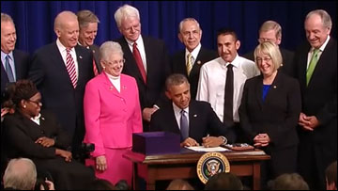
WIOA 101: Introduction to the New Law

Slide 2
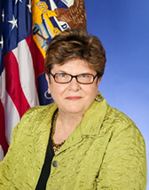
Presented by Gerri Fiala
Deputy Assistant Secretary
Gerri Fiala
Deputy Assistant Secretary
Employment and Training Administration
U.S. Department of Labor
Have a question or comment about WIOA? E-mail DOL.WIOA@dol.gov
Notes:
Presenter introduces her/himself and indicates what this section will cover.
This section will cover the following topics related to introducing the new law, WIOA:
Vision and Message of ETA
Sox Broad Goals of WIOA
Program Alignment
WIOA Titles
Transitioning to WIOA

Slide 3
Vision
To achieve and maintain an integrated, job-driven workforce system that links our diverse, talented workforce to our nation’s businesses and improves the quality of life for our citizens.
Based on three key pillars of our system:
One-Stop career centers provide first-rate customer service to jobseekers, workers, and businesses.
The demands of businesses and workers drive workforce solutions.
The workforce system supports strong regional economies.
WIOA

Slide 4
Six Broad Goals of WIOA
Increase access to education, training, and employment--particularly for people with barriers to employment.

Slide 5
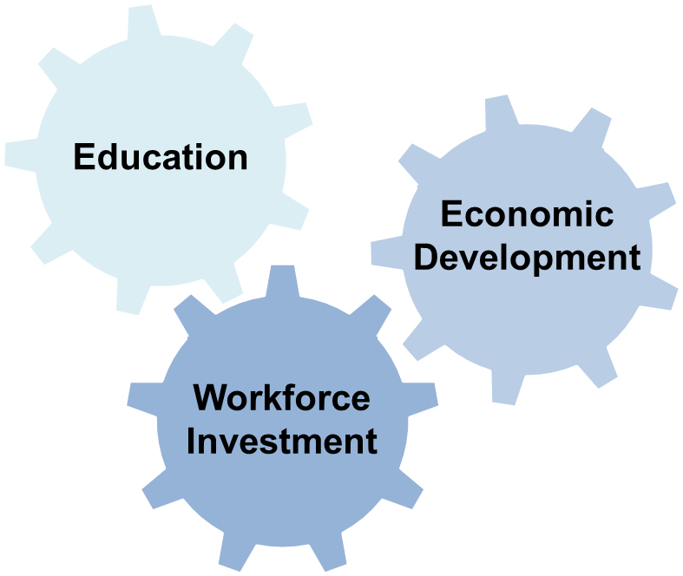
Six Broad Goals of WIOA
Create a comprehensive, high-quality workforce development system by aligning workforce investment, education, and economic development.

Slide 6
Six Broad Goals of WIOA
Improve the quality and labor market relevance of workforce investment, education, and economic development efforts.
Promote improvement in the structure and delivery of services.

Slide 7
Six Broad Goals of WIOA
Increase the prosperity of workers and employers.
Reduce welfare dependency, increase economic self-sufficiency, meet employer needs, and enhance the productivity and competitiveness of the nation.

Slide 8
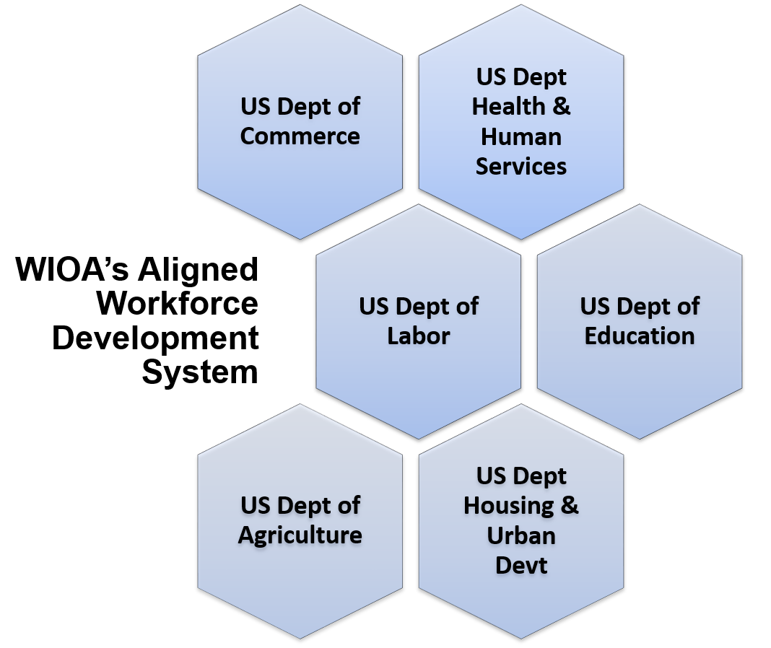
Program Alignment

Slide 9
WIOA Titles
Title I Programs
Title I is the primary source of federal workforce development funding to prepare low-income adults, youth, and dislocated workers for employment, and to help them continue to build skills once they are employed.

Slide 10
WIOA Titles
Title II & Title III Programs
Title II is the main source of federal adult education and literacy funding, including English language services.
Title III funds the Wagner-Peyser Employment Services program, which provides labor exchange services that match employers with qualified job seekers.

Slide 11
WIOA Titles
Title IV Programs
Title IV funds Vocational Rehabilitation which supports a wide range of services designed to help individuals with disabilities prepare for and engage in gainful employment, and secure financial and personal independence through rehabilitative services.

Slide 12
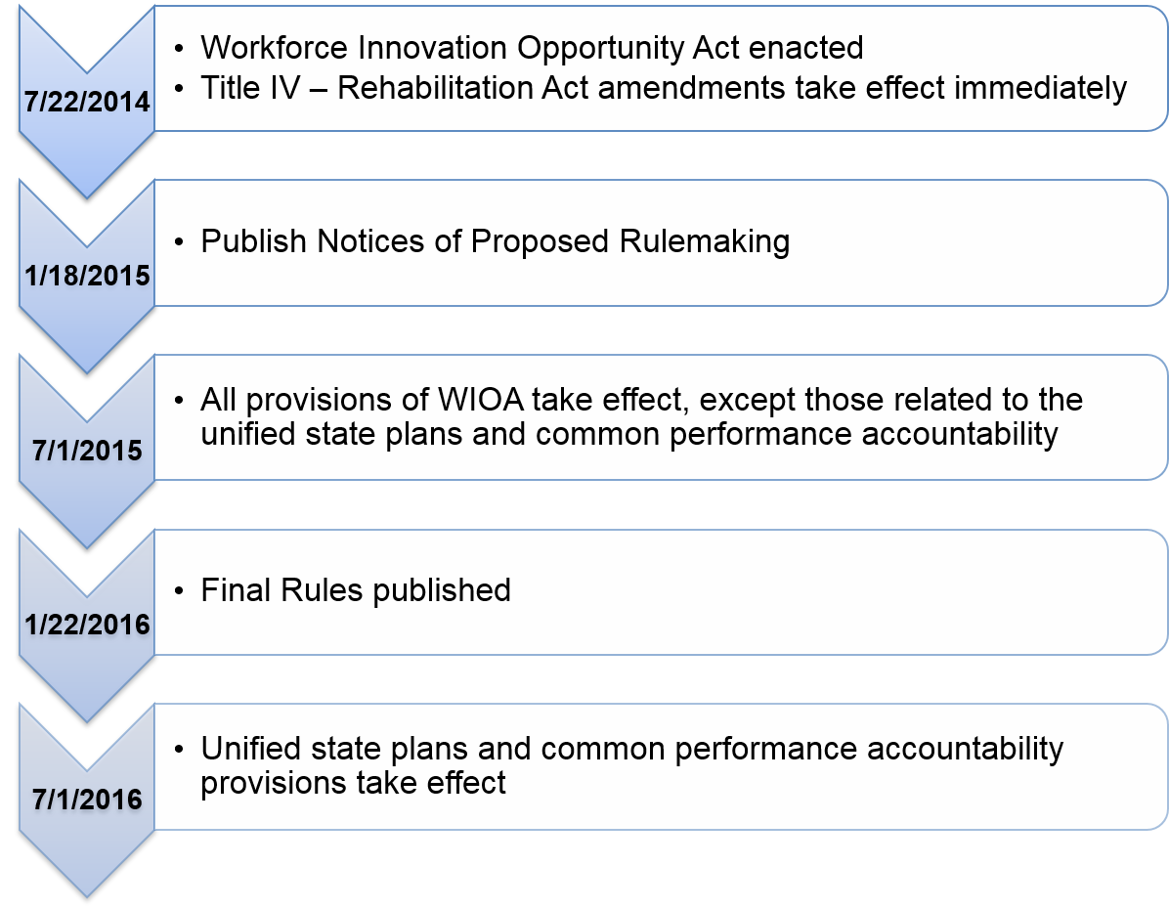
Transitioning to WIOA

