Slide 1
Wagner-Peyser
Employment Services and
Unemployment Insurance

Slide 2
Presenter
Gay Gilbert
Administrator
Office of Unemployment Insurance
Employment and Training Administration
U.S. Department of Labor
Have a question or comment about WIOA? E-mail DOL.WIOA@dol.gov
Notes:
Presenter introduces her/himself and indicates what this section will cover.
This section will cover the following topics related to Wagner-Peyser Employment Services and Unemployment Insurance:
WIOA Impact on Wagner-Peyser
Unemployment Insurance and Wagner-Peyser

Slide 3
WIOA Impact on Wagner-Peyser
Wagner-Peyser Employment Services
Required co-location in One-Stop centers
Required core program and included in unified state plan
Aligned performance metrics
New focus of Governor’s 10% on staff development

Slide 4
Unemployment Insurance and Wagner-Peyser
Enhanced Services for Unemployment Insurance Claimants
Unemployment insurance (UI) claimants are a core customer of the Wagner-Peyser Employment Services program.
UI claimants receive enhanced career services including assistance with UI claims filing and eligibility assessments.
UI claimants receive referrals to an array of training and education resources.
Local plans must include a description of the strategies and services that will strengthen linkages between the one-stop delivery system and unemployment insurance programs

Slide 5
Unemployment Insurance and Wagner-Peyser
One-Stop Centers
Local plans must include a description of strategies and services to strengthen linkages between Unemployment Insurance and One-Stop centers.
Local plans must include a description of the strategies and services that will strengthen linkages between the one-stop delivery system and unemployment insurance programs

Slide 6
Unemployment Insurance and Wagner-Peyser
Data-driven Service Delivery and Performance Accountability
Unified state plans require focus on integrated data systems across core, education, and UI programs.
Labor market and workforce information is a critical foundation for workforce strategies and a key career service to be delivered through the One-Stop system.
WIOA envisions continuous improvement of labor market and workforce information through collaboration among federal agencies, states, and the new Workforce Information Advisory Council.

Slide 7
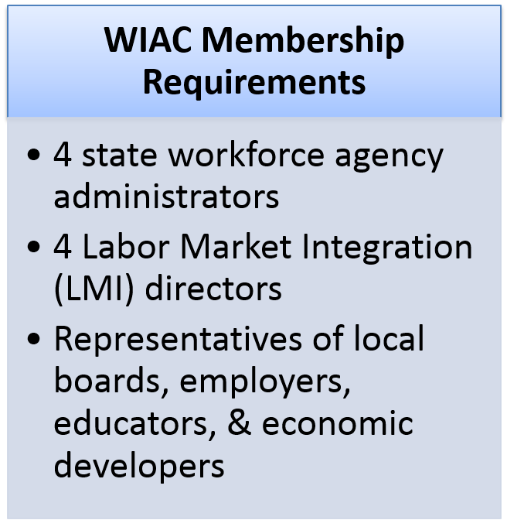
WIOA Impact on Wagner-Peyser
WIC
WIAC
WIOA restructures the
Workforce Information
Council (WIC)
into the
Workforce Information Advisory Council (WIAC)

