Slide 1
National Dislocated Worker Grants (formerly National Emergency Grants)

Slide 2
Presenter
Greg Hitchcock
Employment and Training Administration
U.S. Department of Labor
Have a question or comment about WIOA? E-mail DOL.WIOA@dol.gov
Notes:
Presenter introduces her/himself and indicates what this section will cover.
This section will cover the following topics related to National Dislocated Worker Grants:
National Dislocated Worker Grants
Disaster National Dislocated Worker Grants
Regular National Dislocated Worker Grants
Other National Dislocated Worker Grant Changes

Slide 3
National Dislocated Worker Grants
The name of the grants was changed under WIOA:
WIA = National Emergency Grants, or NEGs
WIOA = National Dislocated Worker Grants
As was the case under WIA, WIOA provides for two types of National Dislocated Worker Grants:
Disaster
Regular

Slide 4
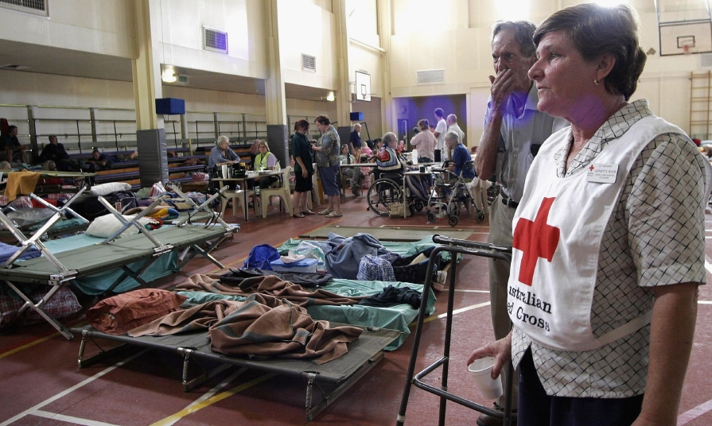
Disaster National Dislocated
Worker Grants
WIOA provides for two new qualifying events:
Emergency or disaster situation of national significance.
Situations where a substantial number of individuals relocate to another area from the disaster area.

Slide 5
Disaster National Dislocated
Worker Grants
New Participant Eligibility
WIOA extends eligibility under disaster grants to self-employed individuals who become unemployed or significantly underemployed as a result of the emergency or disaster.

Slide 6
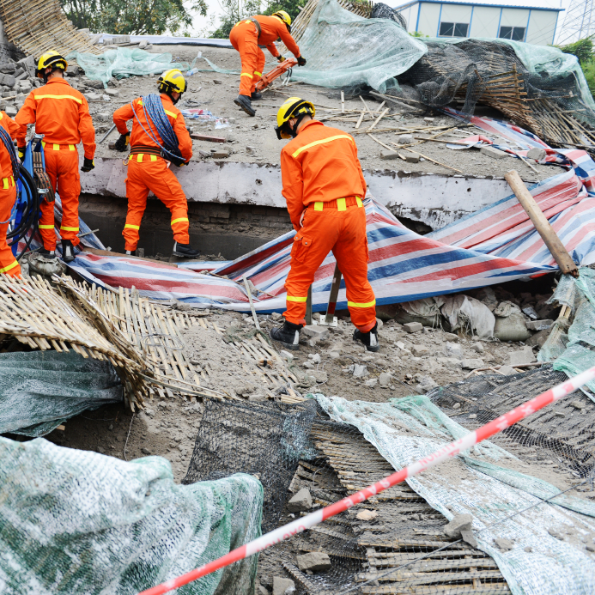
Disaster National Dislocated Worker Grants
Temporary Employment Duration
The maximum duration for disaster relief employment was increased from 6 months under WIA to 12 months under WIOA.
In addition, the Secretary of Labor has the authority to extend the duration of disaster relief employment for an additional 12 months upon request with sufficient justification.

Slide 7
Regular National Dislocated Worker Grants
WIOA provides for a new qualifying event:
Higher than average demand for services from certain members of the Armed Forces and military spouses which exceeds the capacity of state and local resources.

Slide 8
Other National Dislocated Worker Grant Changes
WIOA contains a requirement that decisions on grant applications be made within 45 calendar days.
Some changes to align with broader WIOA changes:
New participant eligibility resulting from the inclusion of military spouses in the dislocated worker and displaced homemaker definitions.
Core and intensive services are now called career services.

