Slide 1
Target Populations
and National Programs

Slide 2
Presenter
Kim Vitelli
Division Chief of National Programs, Tools, and Technical Assistance
Office of Workforce Investment
Employment and Training Administration
U.S. Department of Labor
Have a question or comment about WIOA? E-mail DOL.WIOA@dol.gov
Notes:
Presenter introduces her/himself and indicates what this section will cover.
This section will cover the following topics related to target populations and national programs:
Services to youth and adults with disabilities
Services to veterans and military spouses
National Farmworker Jobs Program
Indian and Native American programs
YouthBuild

Slide 3
Services to Youth and Adults
with Disabilities
WIOA increases access to high quality workforce services for individuals with disabilities and prepares them for competitive, integrated employment.

Slide 4
Services to Youth and Adults
with Disabilities
One-Stop centers will be physically and programmatically accessible for individuals with disabilities.
Youth with disabilities will receive extensive pre-employment transition services so they can successfully obtain competitive, integrated employment.

Slide 5
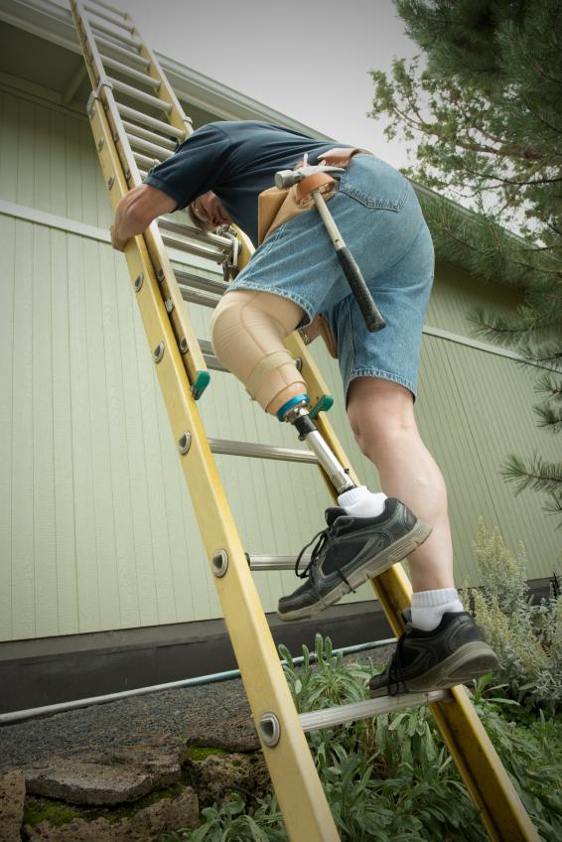
Services to Youth and Adults
with Disabilities
State Vocational Rehabilitation (VR) and WIOA
State Vocational Rehabilitation agencies will set aside at least 15% of funding to provide transition services to youth with disabilities.
VR state grant programs will engage employers to improve participant employment outcomes.

Slide 6
Services to Youth and Adults
with Disabilities
WIOA establishes a committee to advise the Secretary of Labor on strategies to increase competitive integrated employment for individuals with disabilities.
The committee will include the Departments of Labor, Education, Health and Human Services, Social Security Administration, and other partners.
Committee webpage: www.dol.gov/odep/topics/WIOA.htm

Slide 7
Services to Youth and Adults
with Disabilities
Local boards may designate a standing committee
to provide:
Information and to assist with operational and other issues related to compliance with non-discrimination and accessibility requirements.
Input regarding appropriate training for staff on these issues.

Slide 8
Services to Veterans and
Military Spouses
Priority of service requirements for eligible veterans and spouses continue under WIOA.

Slide 9
Services to Veterans and
Military Spouses
National Dislocated Worker Grants Eligibility for grants expanded to areas that have higher than average demand for services from dislocated members of the Armed Forces and other eligible individuals.
Dislocated Worker Program Spouses of certain active duty members of the Armed Forces are included in the definition of dislocated workers and displaced homemakers eligible for assistance.

Slide 10
National Farmworker Jobs
Program
WIOA reauthorizes program
Extends grant period from 2 to 4 years
Applies common performance measures
Removes local workforce board representation requirement
Requires partnership with One-Stop centers

Slide 11
Indian and Native American
Programs
WIOA reauthorizes programs
Extends grant period from 2 to 4 years
Applies common performance measures
Removes local workforce board representation requirement
Requires partnership with One-Stop centers
Requires consultation with the Native American Employment and Training Council to develop additional performance measures

Slide 12
YouthBuild
In addition to construction, WIOA amends YouthBuild to specifically authorize activities in in-demand industries and occupations.
WIOA incorporates common performance measures.
WIOA changes the percentages of funds used for supervision, training, and administration.

