Slide 1
Youth Program

Slide 2
Presenter
Jen Troke, Division Chief
Jennifer Kemp, Unit Chief
Office of Workforce Investment
Employment and Training Administration
U.S. Department of Labor
Have a question or comment about WIOA? E-mail DOL.WIOA@dol.gov
Notes:
Presenter introduces her/himself and indicates what this section will cover.
This section will cover the following topics related to Youth Programs:
Changes to youth eligibility
New youth program elements
Emphasis on work-based learning
Other key provisions

Slide 3
Changes to Youth Eligibility
Out-of-School Youth
To be eligible youth must be:
Aged 16 to 24
Meet one or more additional conditions

Slide 4
Changes to Youth Eligibility
Out-of-School Youth – Additional Conditions
School dropout
Within the age of compulsory school attendance, but has not attended school for at least the most recent complete school year calendar quarter
Recipient of a secondary school diploma or its recognized equivalent who is low-income and basic skills deficient or an English language learner
Subject to the juvenile or adult justice system
A homeless individual defined in sec. 41403(6), Violence Against Women Act (42 U.S.C. 14043e–2(6))), a homeless child or youth, a runaway, in foster care or has aged out of the foster care system, a child eligible for assistance under section 477, Social Security Act (42 U.S.C. 677), or in an out-of-home placement
Pregnant or parenting
An individual with a disability
Low-income individual who requires additional assistance to enter or complete an educational program or to secure or hold employment

Slide 5
Changes to Youth Eligibility
In-School Youth
To be eligible youth must be:
Aged 14 to 21
Low-income*
And one or more additional conditions
* Youth receiving or eligible to receive a free or reduced price school lunch are considered
“low income” under WIOA

Slide 6
Changes to Youth Eligibility
In-School Youth – Additional Conditions
Basic skills deficient
English language learner
An offender
Homeless, a runaway, in foster care or has aged out of the foster care system
Pregnant or parenting
Disabled
Requires additional assistance to enter or complete an educational program or to secure or hold employment

Slide 7
New Youth Program Elements
Five New Elements (total of 14 program elements)
Financial literacy
Entrepreneurial skills training
Services that provide labor market and employment information in the local area
Activities that help youth transition to postsecondary education and training
Education offered concurrently with and in the same context as workforce preparation activities and training for a specific occupation or occupational cluster

Slide 8
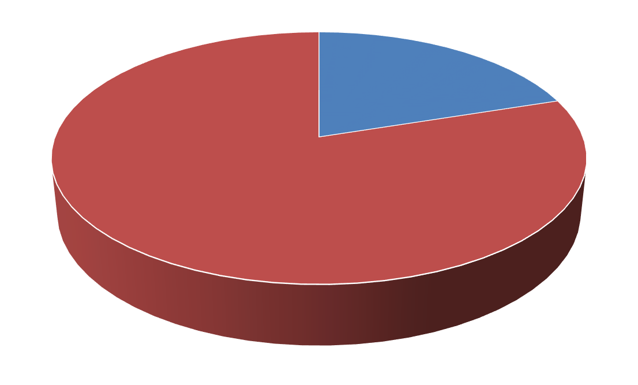
Emphasis on Work-based
Learning
Funding Work Experiences
At least 20% of local Youth formula funds must be used for work activities such as:
Summer jobs
Pre-apprenticeship
On-the-job training
Internships
20%
Local Youth Formula Funds

Slide 9
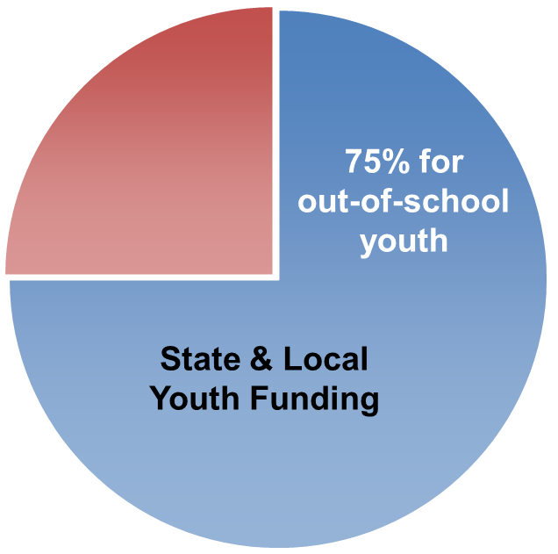
Other Key Provisions
WIOA requires 75% of state and local Youth funding be used for out-of-school youth.
50% exception for states that receive a minimum allotment.
Under WIOA, Youth Councils are no longer required; however, Standing Youth Committees are encouraged.

