Slide 1
Robust and Effective Services to Jobseekers and Workers

Slide 2
Presenter
Robert Kight
Director, Adult Services and Workforce System
Office of Workforce Investment
Employment and Training Administration
U.S. Department of Labor
Have a question or comment about WIOA? E-mail DOL.WIOA@dol.gov
Notes:
Presenter introduces her/himself and indicates what this section will cover.
This section will cover the following topics related to services to jobseekers and workers:
Career services
Support for work-based learning
Priority of service
State and local funding
Transferring and targeting funding

Slide 3
Career Services
Former WIA core and intensive services are merged under WIOA into a single new category of Career Services.
Under WIOA, individuals have enhanced access to training by ensuring there is no sequence of service requirement.

Slide 4
Support for Work-based
Learning
WIOA allows local boards to fund proven work-based strategies.
Reimbursement rates have increased for employers offering on-the-job training and customized training.

Slide 5
Priority of Service
Job seekers who are basic skills deficient now have priority for Adult program services along with low-income job seekers and public assistance recipients.

Slide 6
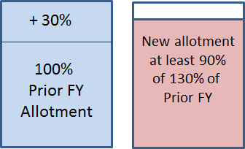
State and Local Funding
State Dislocated Worker Formula FY 2016+
Reduces volatility
Consistent with Adult program funding
Based on prior fiscal year allotment

Slide 7
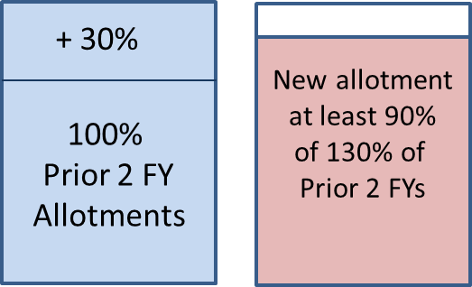
State and Local Funding
Local Dislocated Worker Formula FY 2016+
Reduces local funding volatility
Based on prior two fiscal year allotments

Slide 8
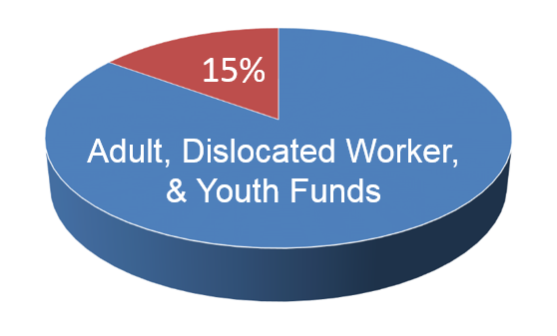
Transferring and Targeting
Funding
Funding from State Governors
Governors can allocate up to 15% of Adult, Dislocated Worker,
and Youth funds for statewide activities.

Slide 9
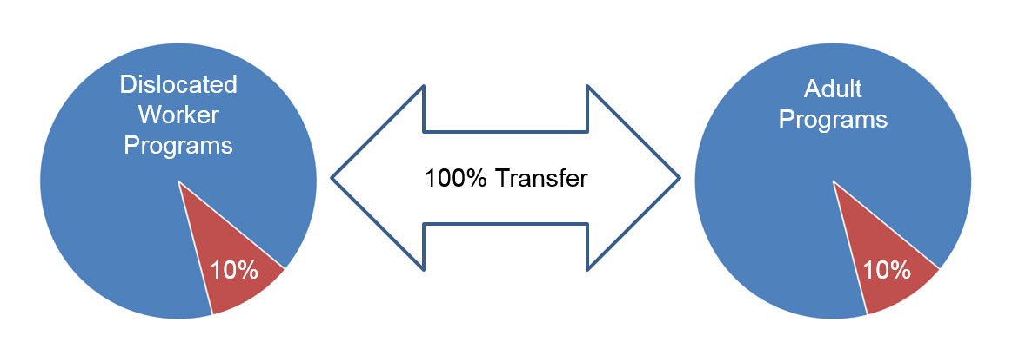
Transferring and Targeting
Funding
Local Boards
Local boards can transfer 100% of funds between Dislocated Worker and Adult programs.
Up to 10% of both funds can be used for transitional jobs for individuals with barriers to employment.

