Slide 1
Prince George’s County Local Workforce Development Board New Member Orientation
FY21

Slide 2
Common Acronyms
DORS – Division of Rehabilitation Services
DSS – Department of Social Services
LWDB – Local Workforce Development Board
GWDB – Governors Workforce Development Board
MD DOL – Maryland Department of Labor
EDC – Prince George’s County Economic Development Corporation
EPG – Employ Prince George’s
PGCC – Prince George’s Community College
CWP – Construction Works Program
EPIC – Educational Partnership for IT Careers
SEWDP – Sustainable Energy Workforce Development Program
HAI – Hospitality & Accommodation Institute
CAHA – Capital Area Healthcare Alliance
IT – Information Technology
WIOA – Workforce Innovation and Opportunity Act
DOL – United States Department of Labor
PGCPS – Prince George’s County Public Schools
BOD – Board of Directors
DFS – Prince George’s County Department of Family Services
OCS – Prince George’s County Office of Central Services
KEYS – Knowledge Equals Youth Success
AJC – American Job Center
AJCCN – Prince George’s County American Job Center Community Network
CFR – Code of Federal Regulations
WIA – Workforce Innovation & Opportunity Act
CLEO – Chief Local Elected Official
CEO – Chief Elected Official
PGC – Prince George’s County
UMD – University of Maryland
BSU – Bowie State University
UMUC – University Maryland University College
RSA – Resource Sharing Agreement
YCC – Youth Career Connection
PTS – Pathways to Success
VCC – Veterans Career Connection
LMB – Local Management Board
OMB – Office of Management & Budget
SYEP – Prince George’s County Summer Youth Enrichment Program
OHRM – Prince George’s County Office of Human Resources Management

Slide 3
Orientation Objectives
The Workforce Innovation and Opportunity Act (WIOA) created smaller, nimbler, more strategic State and Local Boards
Today we will:
Introduce the Prince George’s County LWDB
Explain key requirements for Local Board functions
Discuss key transparency and internal controls

Slide 4
Agenda
Maryland Public Workforce System
Prince George’s County LWDB
Functions of a Local Board
Consumer Choice and Training
Sunshine Policy
Staffing a Local Board
Local Board as a Direct Provider
Functions of a fiscal agent
Internal controls and conflicts of interest

Slide 5
Maryland Public Workforce System
12 Local Areas
Prince George’s County
Governing Entities - State
Maryland Department of Labor (MD DOL)
Governors Workforce Development Board
Governing Entities – Local
Office of the County Executive
Prince George’s County Local Workforce Development Board (LWDB)

Slide 6
Mission To provide strategic direction that drives innovation, guiding the success of the workforce system locally & regionally to prepare individuals for the labor market – connecting a qualified & diverse workforce to the business community.
Prince George’s County Local Workforce development board

Slide 7
Our Roles as a LWDB
Identify & engage career services providers
A convener of stakeholders to provide strategy, goals, innovation (including technology), and oversight
To ensure integration of services to our hardest-to-serve populations, coordinating with education & training providers
To provide leadership, guidance, and leveraging of resources for workforce development efforts to improve sustainable employment opportunities
To provide governance, strategic planning (providing input for regional workforce plan), and fiduciary guidance
Engage in regional labor market analysis – focused on needs of our community
Identify promising practices in engaging businesses
Career Pathway development & design

Slide 8
Prince George’s County LWDB
Chief Local Elected Official (CLEO)
Angela D. Alsobrooks
LWDB Leadership
Chair – Charnetia Young, CVS Health
Vice-Chair – Dawnn Leary, Community Foundation
Executive Director – Walter Simmons
Board Manager – Jamie Gunnell
Committees
Executive Committee
American Job Center/One Stop System Committee
Youth Committee
Finance Committee
Disabilities & Severe Barriers Committee
Business Committee
Administrative Entities
Board Administrative Staff – EPG
Fiscal Agent - EPG
Meeting Times
3rd Wednesday of Every Other Month @ 9am
Committee Meetings (As designated by Committee)
Bylaws
Local Area Operations Agreement
EPG & WDB Agreement
Local Plan (2016-2020)*
Funding Sources
WIOA
Adult – MD DOL
Dislocated Worker – MD DOL
Youth – MD DOL
Summer Youth Connections – MD DOL

Slide 9
WIOA Vision
The workforce system will be characterized by three critical hallmarks of excellence:
The needs of business and job seekers drive workforce solutions;
One Stop Career Centers (American Job Centers) provide excellent customer service to jobseekers and businesses and focus on continuous improvement; and
The workforce system supports strong regional economies and plays an active role in community and workforce development.
Across the system, continuous improvement is supported through evaluation, accountability, identification of best practices, and data driven decision making.

Slide 10
Local Boards are Key to WIOA
Local Boards are key to Implementing WIOA Priorities:
Career Pathways
Employer Engagement
Work-based Learning
Sector Strategies
Partnerships
Integrated Service Delivery

Slide 11
Local Boards Vision
Serve as the strategic leader and convener of local workforce development system stakeholders.
Partner with employers and with the workforce development system
Support regional economies, and development of sector strategies and career pathways
Support high quality, customer centered service delivery.

Slide 12
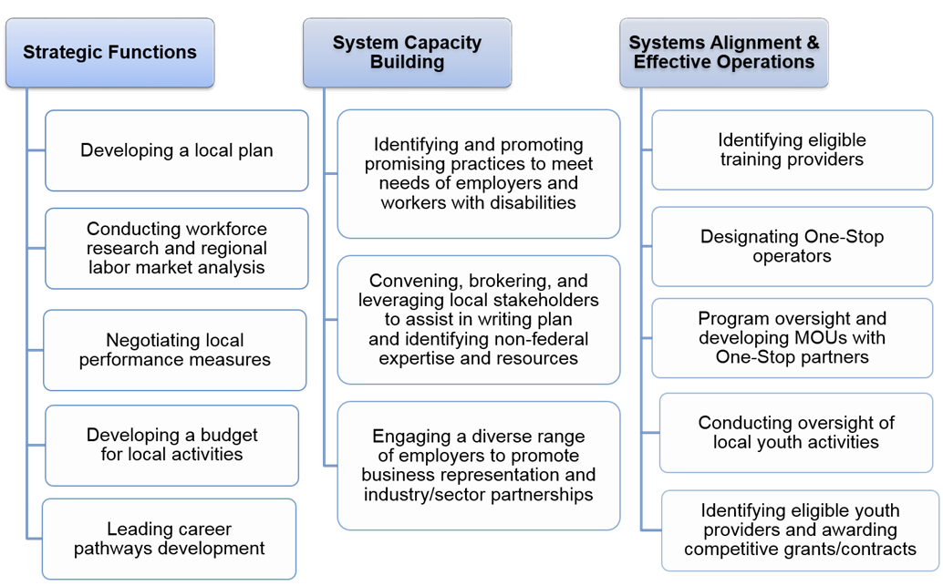
Local Boards Responsibilities

Slide 13
Training Providers
679.380: Consumer Choice Requirements
Local Workforce Development Boards MUST provide consumers with choices for career and training services.

Slide 14
Training Providers
Maintain a comprehensive and current list of Local Eligible Training Providers
Ensure it is accessible, user-friendly
Includes providers who:
specialize in serving individuals with disabilities and
have expertise with adult education and literacy activities
Case managers and participants walk through the list together

Slide 15
Career Service Providers
Explore menu of career services and service providers in the community
Award contracts when needed
Specialize in assisting individuals with disabilities prepare for and find employment
Expertise in Adult Education and Literacy

Slide 16
Career Service Providers
679.390: Sunshine Policy
Local Workforce Development Boards MUST conduct business in an Open Manner

Slide 17
How?
Be accessible and transparent. Available to the public, on a regular basis through electronic means and open meetings

Slide 18
Transparency Test
PASS
“Go to our website for all the members, the dates and locations of our meetings, notes, and bylaws.
Read our plan. Looking for a service provider? Interested in being a service provider?
Check out our website, updated regularly.”
FAIL
“Of course our information is publically available—just come to the office between 9am-4pm Tuesday – Thursday and ask the secretary to see the binder at her desk.”
“Our information is totally public. We post the members on the bulletin board at the One Stop. Anyone in the One Stop can see it.”
“We have a website where we post our members and our annual meeting. You can get a copy of the plan by request.”

Slide 19
What’s Covered in 679.390
Information about the Local Plan, or modification to the Local Plan, before submission of the plan;
List and affiliation of Local WDB members;
Selection of one-stop operators;
Award of grants or contracts to eligible training providers of workforce investment activities including
Workforce investment activities;
Providers of youth workforce investment activities;
Minutes of formal meetings of the Local WDB; and
Local WDB by-laws, consistent § 679.310(g)

Slide 20
Board Staff
679.400: Staffing the Local WDB
Local Workforce Development Boards MAY hire a Director and other staff to help carry-out the boards’ functions

Slide 21
Board Staff Parameters
Establish and apply an objective set of qualifications for the Director
Ensure workforce experience, skills & abilities
Assist board with its required WIOA functions
Exceptions require a written agreement as described in 679.430

Slide 22
Fiscal Agent Functions
679.420: What are the functions of the local fiscal agent?
Chief Elected Officials may designate an entity to serve as a local fiscal agent with clearly defined roles and responsibilities.

Slide 23
Fiscal Agent 6 Things to Know
Receive funds
Ensure funds expenditures and accounting follow all OMB circulars, WIOA and its regulations, and State policies
Respond to financial audits
Maintain accounting records
Prepare LWDB, state and federal financial reports
Provide technical assistances on fiscal matters to sub-recipients

Slide 24
Fiscal Agent Parameters
Fiscal agents cannot act without direction from the local workforce development board—they are not decision making entities but carry out certain operational functions
If a local workforce development board or State Board in a single-area state authorizes it, a fiscal agent may:
Procure contracts and written agreements
Conduct financial monitoring of service providers
Ensure independent audits

Slide 25
Multiple Roles of a Fiscal Agent
679.430. How do entities performing multiple functions in a local area demonstrate internal controls and prevent conflict of interest?
Local organizations often wear several hats– i.e. fiscal agent and service provider or one-stop operator and service provider.
Where multiple functions are performed by a single organization, a written agreement with the local board and CLEO must clarify responsibilities, be in line with State conflict of interest policies, and demonstrate compliance with WIOA, regulations and OMB circulars

Slide 26
Fiscal Agent DON’T’S
When the local fiscal agent makes major purchases without Local Board approval.
When the fiscal agent is also a service provider and issues payments to themselves. Firewalls are needed.
When the local fiscal agent is making policy.
When a fiscal agent is a party to contracts and procurement that it oversees.

Slide 27
Summary
Local Boards are responsible for many functions—Strategy, System Building, Effective Operations.
Effective Boards do business in the open, look at the bigger picture for the local area, use staff wisely, and ensure a wide variety of organizations provide services needed in the community.
CLEO’s and Boards put in place lines of authority and clear separation of roles to ensure fiscal integrity.

Slide 28
Questions

Slide 30
Walter Simmons, Executive Director
(301) 618-8433
WSimmons@co.pg.md.us
Jamie Gunnell, AJCCN/Board Manager
(301) 583-4635
JNGunnell@co.pg.md.us

